Slide 1

Prépa TEF TCF
Practise TEF and TCF Canada in the real exam format.
TEAM FELIX LE
Notes:
Sopulu opens: name the app in one line. About 10 seconds.

Slide 2
01 · THE HOOK
Have you ever failed an exam or test you prepped for, simply because you didn’t know the testing format?
Notes:
Ask it out loud and pause. Ask for a show of hands. About 15 seconds.

Slide 3

02 · MEET PAWAN · ILLUSTRATIVE PERSONA
Pawan, 28
Temporary resident on a work permit, trying to gain permanent residency through IRCC’s French pathway.
He failed his TCF/TEF tests twice: he never practised with the exam format, and had limited access to prep resources.
Notes:
Pawan is an illustrative persona, not a real interviewee. Tell his story in two sentences. About 25 seconds.

Slide 4
03 · WHO FACES THIS
Pawan is not alone.
100,000
300,000
40%
French-pathway candidates IRCC targets
applications received
of those 300,000 have to retake TCF/TEF
Team estimates · source to confirm
Notes:
Give the scale: about 300,000 applications for about 100,000 French-pathway targets, and 40% retake the test. Confirm the source before presenting. About 25 seconds.

Slide 5
How might we help working temporary residents know they are ready for TEF/TCF before they pay for it?
04 · PROBLEM / HOW MIGHT WE
$390
2 weeks
per exam attempt
before a retake, while skills fade
Prépa TEF TCF · free exam-format practice for TEF and TCF Canada
Notes:
Open with the two questions: have you ever felt embarrassed pronouncing a word? How many times did you skip a coffee to pay for an exam? Then the HMW. Candidates pay $390 per attempt and wait two weeks to retake, re-budgeting while their skills fade. About 35 seconds.

Slide 6
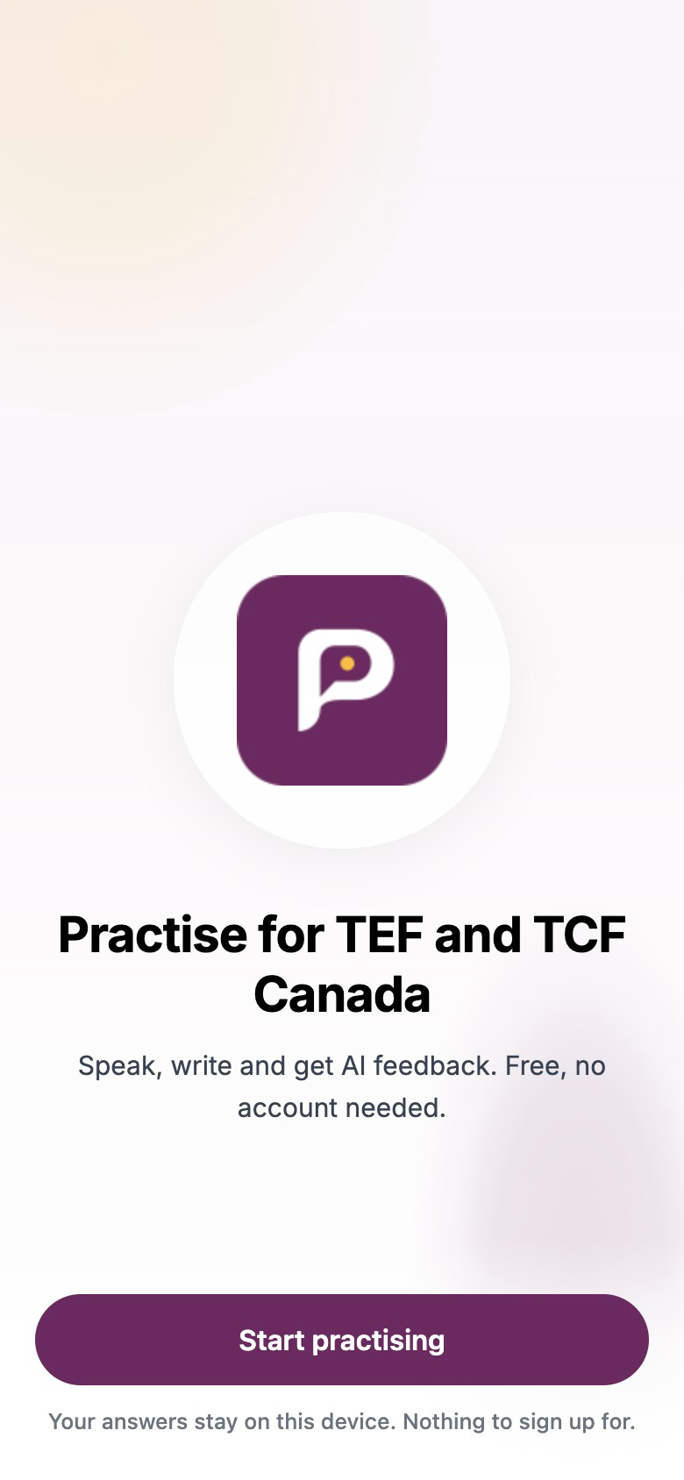
Prépa TEF TCF
05 · SOLUTION
A free proficiency check in TEF and TCF Canada format: listening, reading, writing and speaking. No account, runs in any browser.
Notes:
One line: it evaluates French proficiency in the exam format, at zero cost. It is a testing tool, not a teaching app. About 25 seconds.

Slide 7
The exam’s own format, all four skills, free to start.
06 · UNIQUE VALUE PROPOSITION
Exam format
Evaluate, not teach
AI-scored, no account
Built on TEF/TCF tasks, not general French.
Tells you your level before you pay $390.
Writing and speaking scored by AI. Open in any browser.
Notes:
Why choose us over alternatives: other resources test general speaking ability; we mirror the TEF/TCF format across all four skills, and writing and speaking are scored by an AI model. Free to start. About 25 seconds.

Slide 8
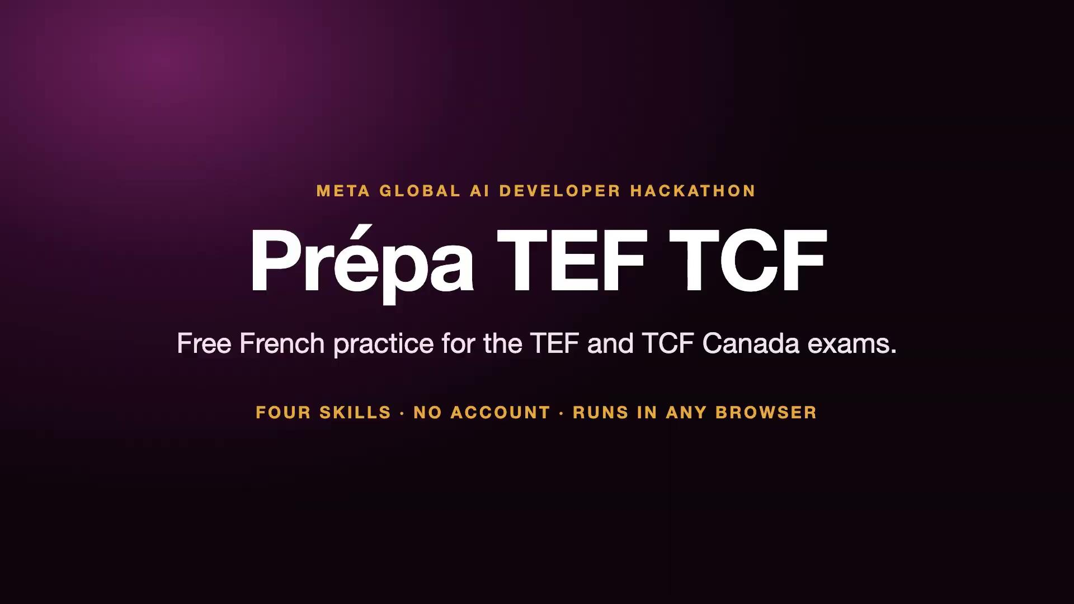
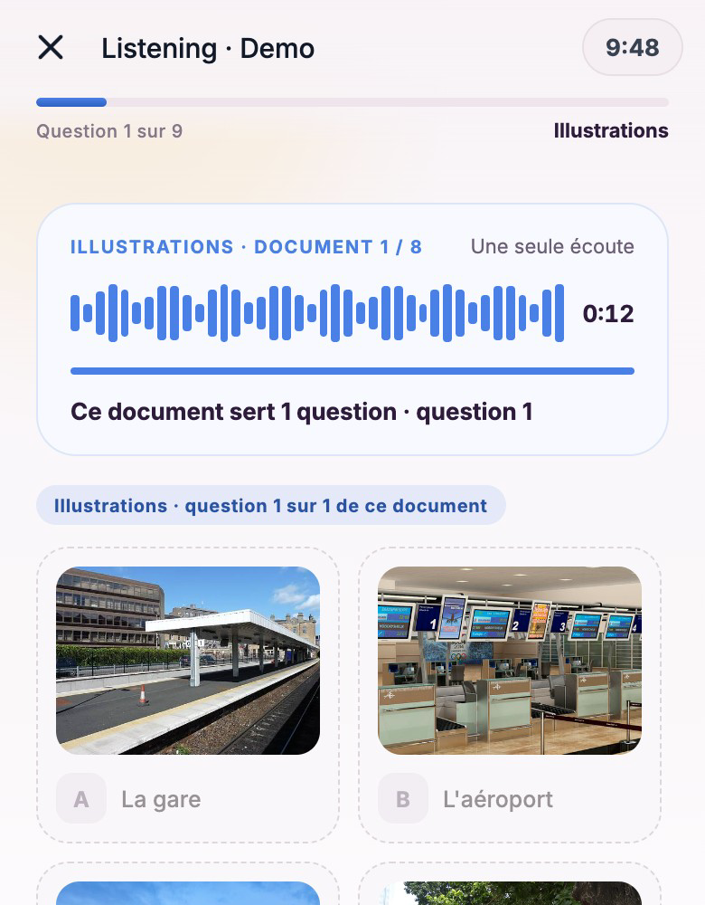
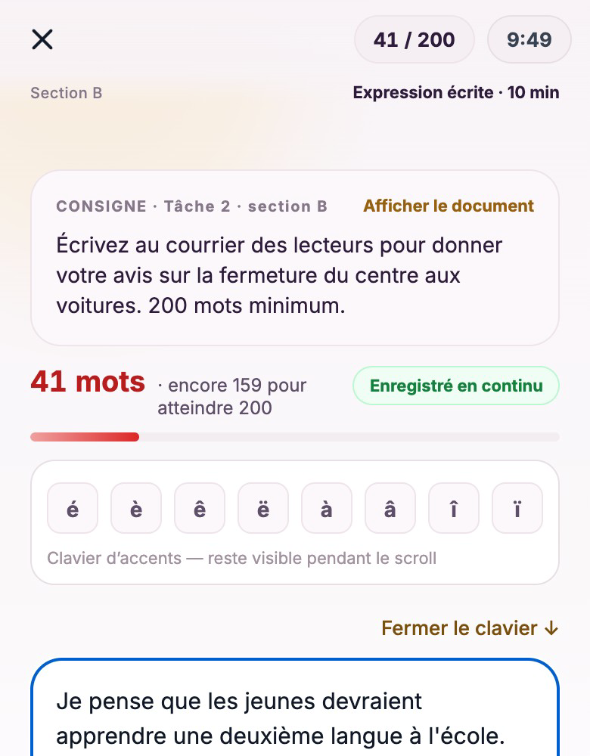
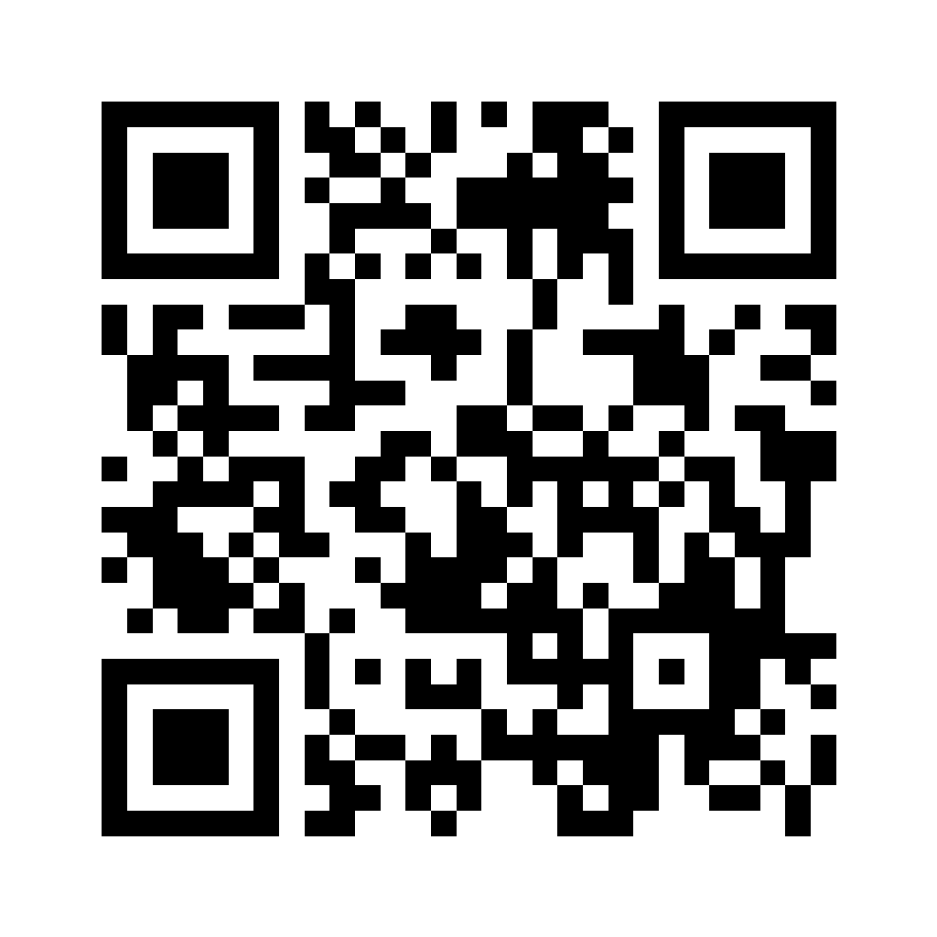
07 · PROTOTYPE · LIVE WEB APP
Demo video
Insert › Video › Google Drive here
Listening
Writing
Scan to try the app now
Demo sections are shortened; full 40-question versions come after launch.
Notes:
Play the demo video, or walk one clear path: listening question, writing with word count, speaking task. Keep it under 45 seconds. The QR code lets judges try the live app on their phones.

Slide 9
A working temporary resident, 25 to 34, aiming for PR through Express Entry or PNP.
08 · TARGET PERSONA
Challenge
Need
Gap
Rent, groceries and car insurance leave little room for $390 retakes.
Know their real level in the exam’s own format before booking.
Most resources test general French, not the TEF/TCF format.
Notes:
Sopulu tells her own story, briefly: I failed my G test because I took it half asleep at 6 am, then had to budget for the retake again. For immigrants and temporary residents, every retake hurts. About 30 seconds.

Slide 10
We have not tested with users yet. Here is how we will find out.
09 · VALIDATION PLAN
Who
Ask
Success
20 temporary residents preparing for TEF/TCF, plus French tutors.
Would this tell you when you are ready to book the $390 exam?
Most say yes, and app levels match their real exam results.
Notes:
Be honest: no user testing yet. Explain the plan: who we will ask, the key question, and what result would prove the need. Judges value how you think. About 25 seconds.

Slide 11
10 · COMPETITORS LANDSCAPE
Option | TEF/TCF format | All 4 skills | Cost
General language apps | No | Partly | Free or subscription
Paid prep courses / tutors | Yes | Yes | Paid, varies
Taking the real exam | Yes | Yes | $390 per try
Prépa TEF TCF | Yes | Yes | Free to start, packs
Notes:
Name one or two real competitors in each row if you know them; fill the course price. About 20 seconds.

Slide 12
Points reward practice. Need more? Buy a point pack.
11 · BUSINESS MODEL
+10
−3
+8
$
Sign up
New test
Complete it
Point packs
Free starting points for every new account.
Each new Reading or Listening test.
Finishing a test earns points back.
Buy points to test more, any time.
Notes:
Walk the loop: 10 free points at sign-up, a new Reading or Listening test costs 3, finishing it earns 8, so regular learners keep practising for free. Anyone who wants more right away buys a point pack, which covers AI scoring costs. Later: referrals to learning platforms by level. About 25 seconds.

Slide 13
12 · SDG IMPACT / NEXT STEPS
SDG 4 · Quality Education
How we measure it
Free, fair access to exam-format French practice for anyone with a browser.
Tests taken, level gained between attempts, and $390 retakes avoided.
Next steps
Full 40-question sections · AI scoring for writing and speaking · Level-based learning recommendations
Notes:
SDG 4: free, equal access to exam preparation. Measure impact by attempts saved and level gained. About 25 seconds.

Slide 14





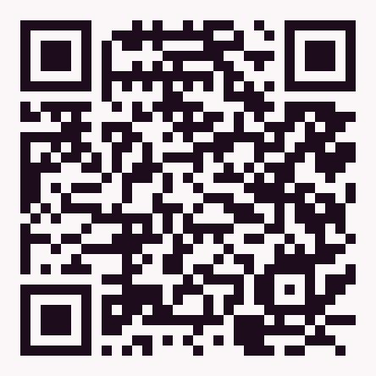
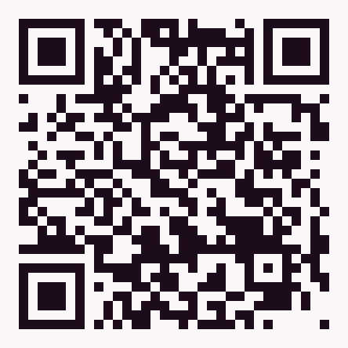


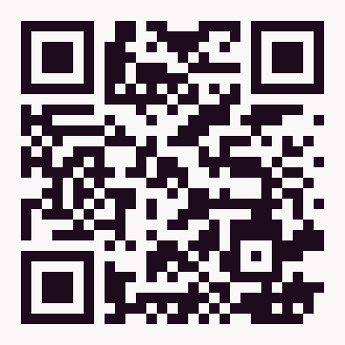
Practise the exam first. Pay for it once.
13 · TEAM AND CLOSE · TEAM FELIX LE
Sopulu Chu-Ebunoha
Yogesh Sharma
Zahra Noorzay
Mrigan Bhalla
Felix Le
Presenter
Editor
Tester · Q&A lead
Team Lead
Product & Engineering
Presenter · Editor
Notes:
Sopulu opens and presents first, Yogesh presents after Sopulu. Introduce each member in one line, repeat the promise, thank the judges. Q&A: Mrigan leads and routes questions; Felix takes product and tech questions. About 20 seconds.

